Slide 1


Subject Code: SIT-1205
Subject Name: Object Oriented Analysis and Design
Faculty Name: Dr.R.Jeberson Retna Raj
Dr.R.M Gomathi

Slide 2
UNIT 3 OBJECT ORIENTED ANALYSIS
Business Object Analysis - Use Case Driven Object Oriented Analysis - Business Process Modeling - Use Case model - Developing Effective Documentation - Object Analysis Classification: Classification Theory - Noun Phrase Approach - Common Class Patterns Approach - Use-Case Driven Approach - Classes Responsibilities and Collaborators - Naming Classes - Identifying Object Relationships, Attributes and Methods: Association - SuperSubclass Relationships - A-part of Relationships.
.

Slide 3
Identifying object relationships, attributes and methods

Slide 4
Identifying object relationships, attributes and methods
All objects stand in relationship to others.
Three types of relationship.
Association
Super-sub structure(also known as generalization)
Aggregation and a-part-of structure.

Slide 5
1. Association
Association is an relationships among objects.
Super-sub relation allows inheritance.
A-part-of is familiar of organizing components of bigger objects.
Eg. walls, windows, doors, is one part of bigger object building.
Association represents a physical or conceptual connection between two or more objects.

Slide 6
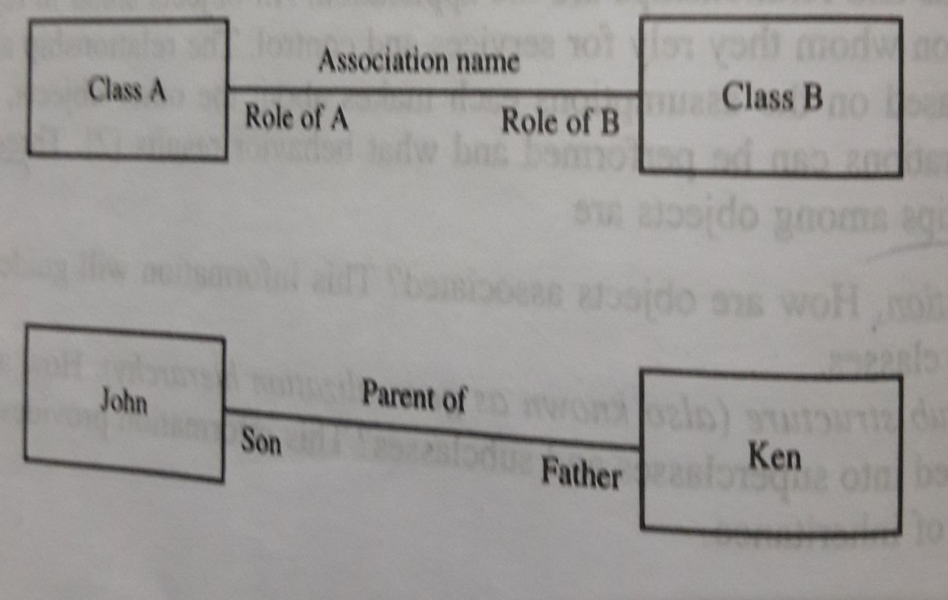
Association
Binary association

Slide 7
Identifying Associations
Begins by analyzing the interactions between classes.
Questions that help
Is the class capable of fulfilling the required task by itself.
If not what does it need.
From what other class can it acquire what it need.

Slide 8
Steps – identifying associations
Extract all candidate associations from the problem statement and get them down on paper.
Refine later.
Guidelines for identifying associations
A dependency between two or more classes may be association
Association often corresponds to a verb or propositional phrase.
A reference from one class to another is association.

Slide 9
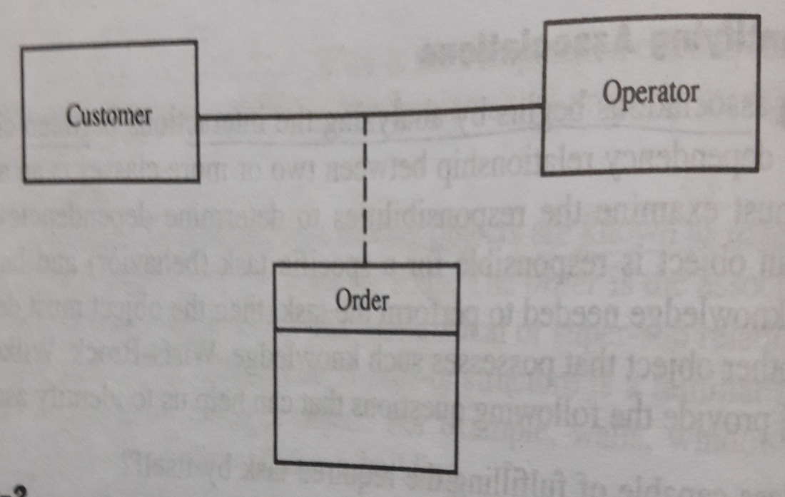
Common association pattern
Location association.
Eg . Next to, part-of,
Communication associations
Eg. talk to, order to

Slide 10
Eliminate unnecessary association
Implementation association
Concerns with the implementation or design of the class within certain programming.
Ternary associations
Is an association among more than two classes.
Ternary association complicate the representation.
If possible change into binary association.

Slide 11
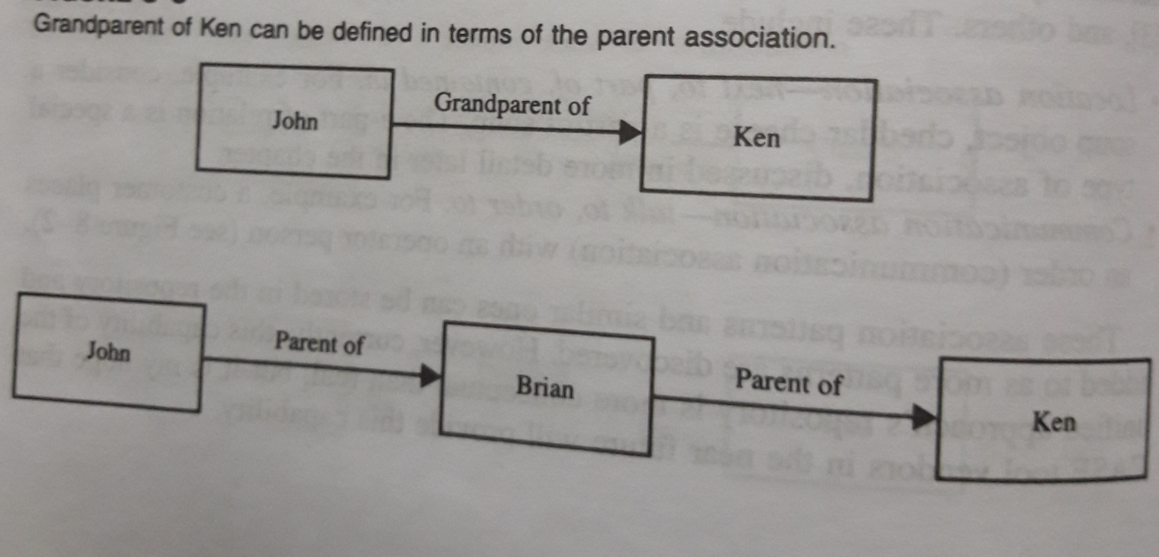
Eliminate unnecessary association
3. Directed actions (or derived ) associations
Can be defined in terms of other associations.
Since they are redundant, avoid these types of associations.

Slide 12
2. Super – Sub class relationship (Generalization)
Represents the inheritance relationship between related classes.
You can modify the existing sub classes as a new one.
Super sub class relationship also known as generalization hierarchy.
Allow object built from other objects.
Advantage
Reuse.
Classes to share and reuse behaviors' and attributes.

Slide 13
Guidelines for identifying super sub class relationship
Top down : look for noun phrases composed of various adjectives in a class name.
Bottom up : look for classes with similar attributes or methods.
Reusability : do not create very specialized classes at the top.
Multiple inheritance: avoid excessive use of multiple inheritance.
Multiple inheritance complicates the design and implementation.

Slide 14
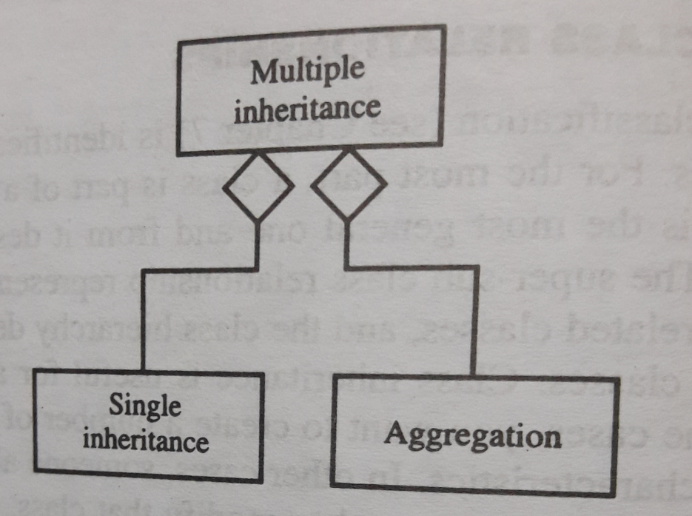
Inherit from the most appropriate class and add an object of another class as an attribute.

Slide 15
3. A-Part-of Relationship – Aggregation
Two properties
Transitivity : if A is part of B and B is part of C, then A is part of C
Antisymmetry : A is part of B, then B is not part of A
Eg. engine is part of a car, but car is not part of an engine.
Filled diamond represents strong form of aggregation which is composition.

Slide 16
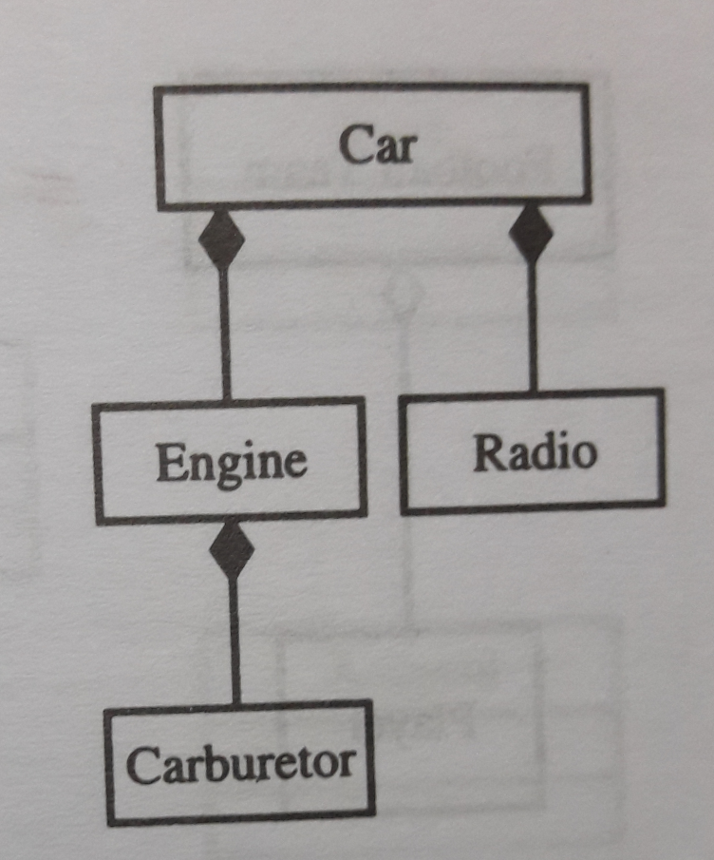
A-Part-of Relationship

Slide 17
A-part of Relationship
Guidelines
Assembly : is constructed from its parts and an assembly –part situation physically exist.
Eg. French onion soup is an assembly of onion, buttor, flour, wine etc.
Container : a physical whole encompasses but not constructed from physical parts.
Eg. house can be considered as a container for furniture and appliances.

Slide 18
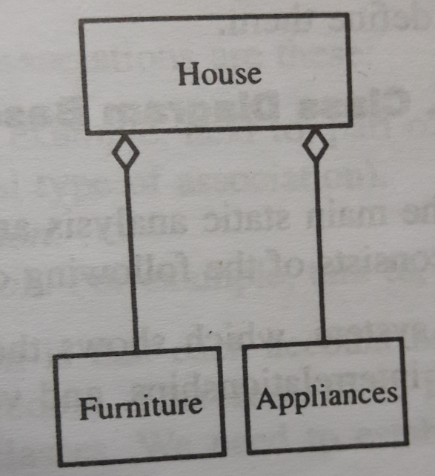
A-Part-of Relationship Patterns
Assembly : is constructed from its parts and an assembly- part situation physically exists.
Example : French onion soup is an assembly of onion, buttor, flour, wine

Slide 19
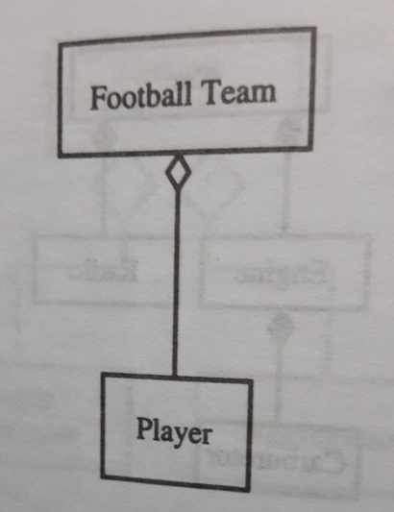
A-Part-of Relationship Patterns
Container : A physical whole encompasses but not constructed from physical parts
Example : House can be considered as a container for furniture and applications.

Slide 20
Q&A - Analysis
1. Mention the steps for finding use cases
For each actor, find the tasks and functions that the actor should be able to perform or that the system needs the actor to perform.
The use case should represent a course of events that leads to a clear goal. Name the use cases.
2. List any two use cases for a “Libraray Management System”?
1.Borrow books
2.Supplier Return books
3.Circulation clerk
3. Get an inter liability loan
4. Do research
5. Read books / news paper
6. Purchase supplier

Slide 21
Q&A - Analysis
3. What is aggregation?
A special form of association that models a whole-part relationship between an aggregate (the whole) and its parts
4.Define actor.
5.When will Uses association, Extends association used?
The use association allows extracting the common sub flow and making it a use case of its own.
For example, checking a library card is common among the borrow books and return books.

Slide 22
Q&A - Analysis
6.What are the guidelines for selecting candidate classes from the relevant & Fuzzy categories of classes
Redundant classes
Do not keep two classes that express the same information. If more than one word is being used to describe the same idea, select the one that is the most meaningful in the context of the system.
• Adjective classes
Adjectives can be used in many ways. An adjective can suggest a different kind of object, different use of the same object, or it could be utterly irrelevant.
• Attribute classes
Tentative objects that are used only as values should be defined or restated as attributes and not as a class.
• Irrelevant classes: Each class must have e a purpose and every class should be clearly defined and necessary.

Slide 23
Q&A - Analysis
7. Define 80-20 Rule. List the guidelines for selecting classes in an application
80 percent of the work can be done with 20 percent of the documentation
The 20 percent is easily accessible and the rest (80 percent) is available to those (few) who need to know.

Slide 24
Q&A - Analysis
8.How would you name classes? List the approaches for identifying classes. Mention the types of object relationships
The class name should be singular.
Choose the class name from standard vocabulary for the subject matter with which the clients or users are comfortable.
The class name should reflect its intrinsic nature.
Use readable names.
Capitalize class names.
Code should be consistent and easy to read.

Slide 25
Q&A - Analysis
Approaches for identifying classes.
o Noun phrase approach
o Common class pattern approach
o Use-case driven approach
o Sequence / Collaboration Modeling
o CRC approach
Types of object relationships
Association
Super-sub structure (generalization hierarchy)
Aggregation and a-part-of structure

Slide 26
Q&A - Analysis
9. List the guidelines for identifying super -sub relationships.
Top-Down: Look for noun phrases composed of various adjectives in a class name.
Bottom-Up: look for classes with similar attributes and methods, in most cases. You can Group them by moving the common attributes and methods to an abstract class
Reusability: Move attributes and behavior as high as possible in the hierarchy.
Multiple Inheritance: Avoid excessive use of multiple inheritances

Slide 27
Q&A - Analysis
10. What is Generalization?
Superclass -subclass relationships, also known as Generalization hierarchy allow objects to be built from other objects
11.What are the guidelines for naming the classes
The class should describe a single object.
It should be singular form of noun.
Use names that the users are comfortable.
The class name should reflect its intrinsic nature.
Use readable names and Capitalize class names (Ex. Loan-Window).

Slide 28
Q&A - Analysis
Differentiate Actors and Use cases
Actors | Use cases
Actor represents the role a user plays with respect to the system. | A use case defines the interactions between external actors and the system A sequence of transactions in a system
An external system that needs information from a current system. | Yields results of measurable values to an individual actor of the system.
Actors can be the ones that get value from the use case | Provides a special flow of events.

